Slide 1
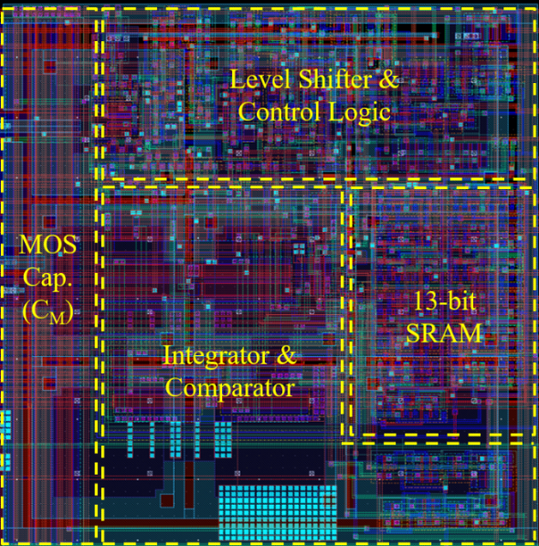
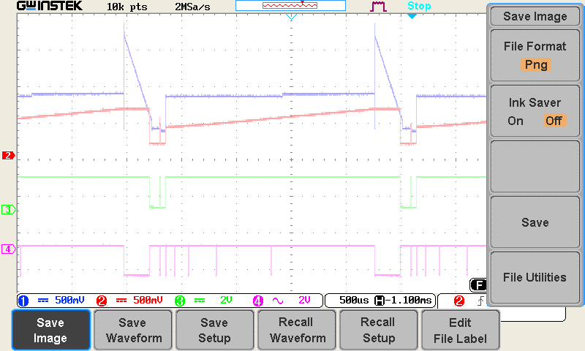
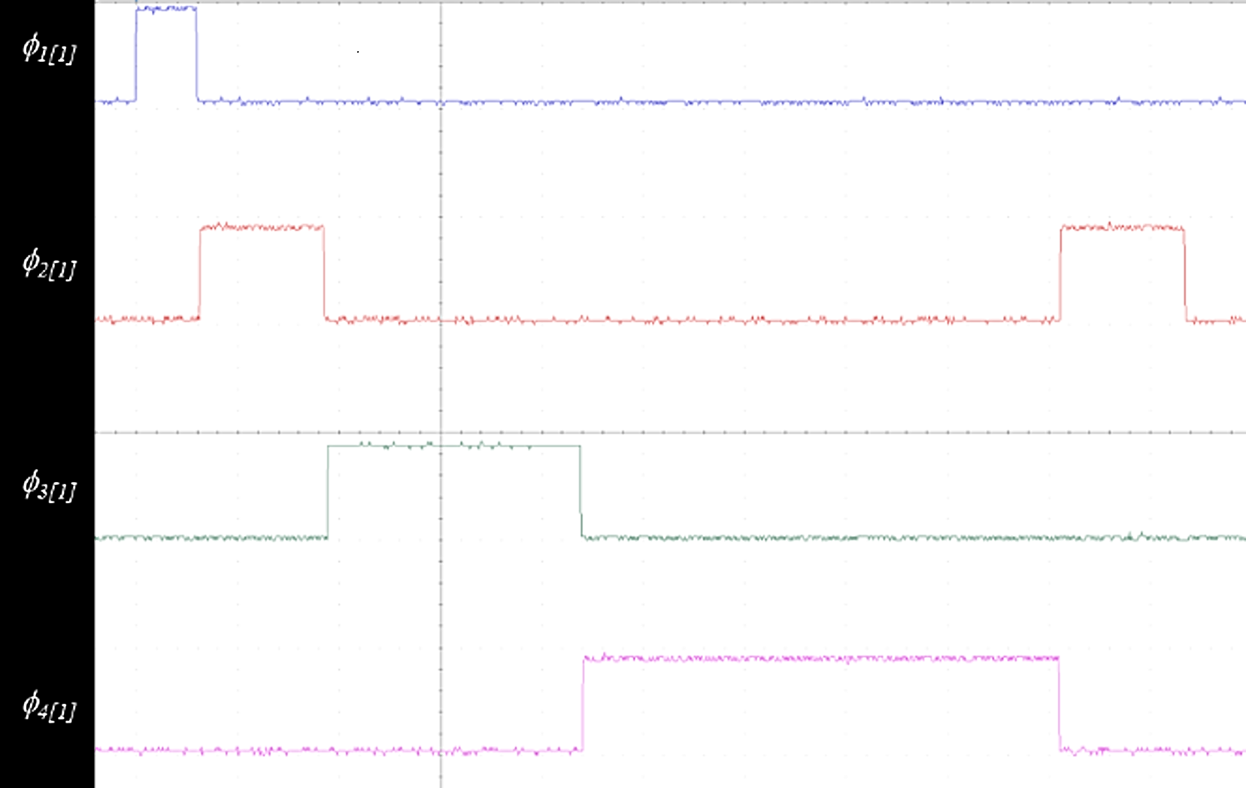
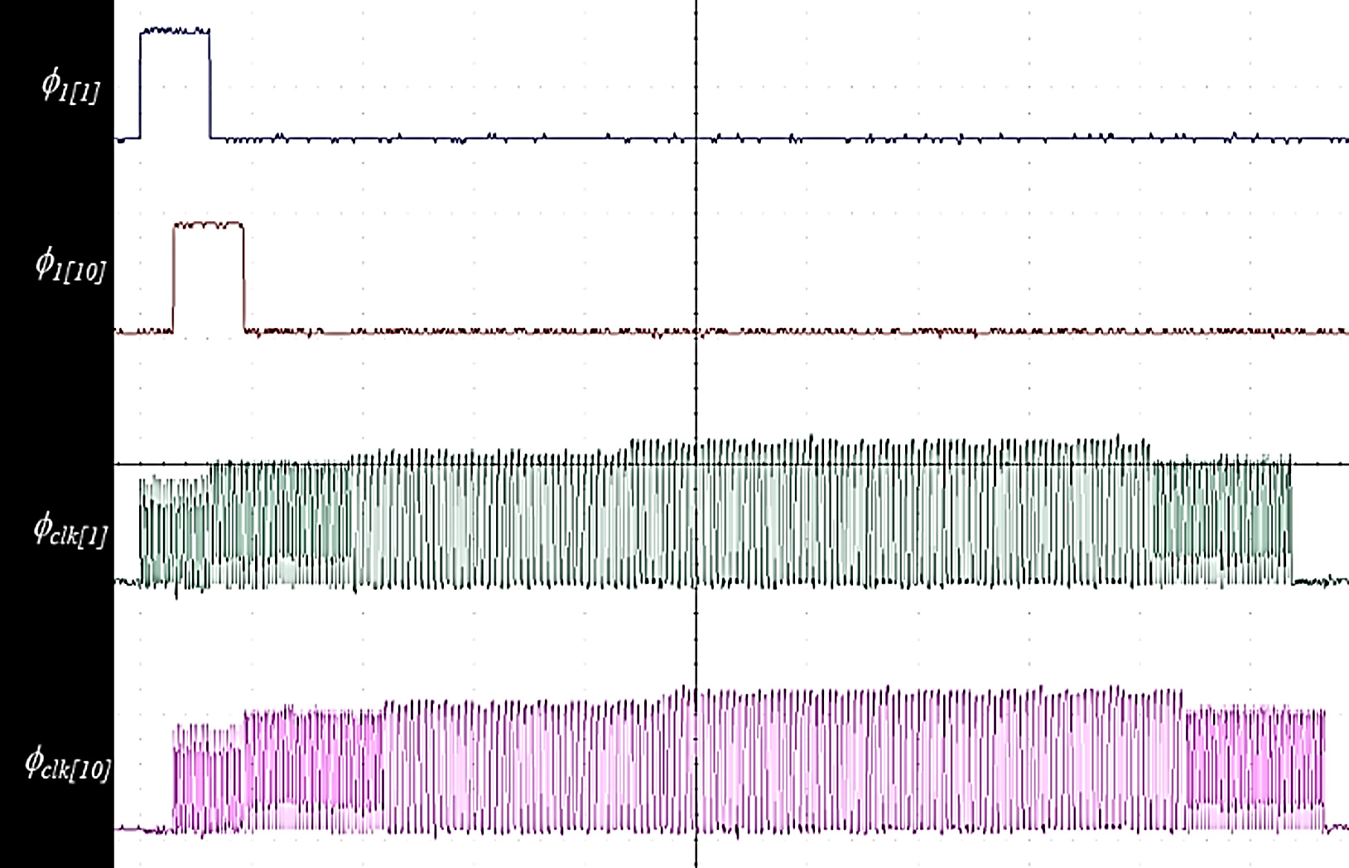
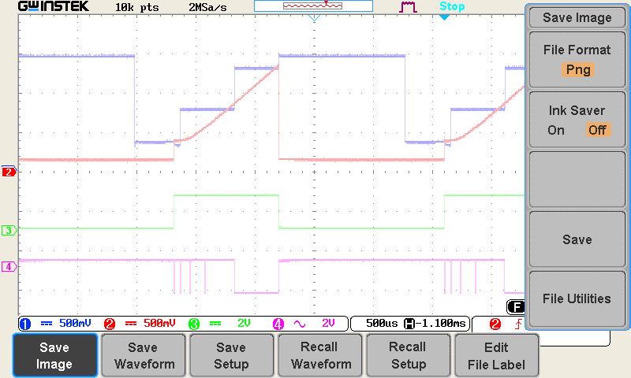
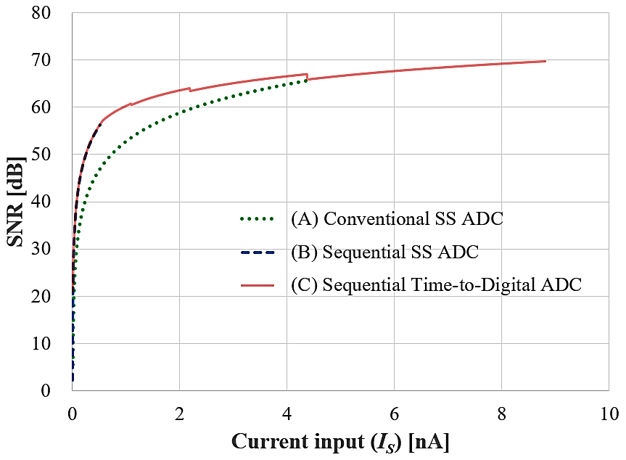
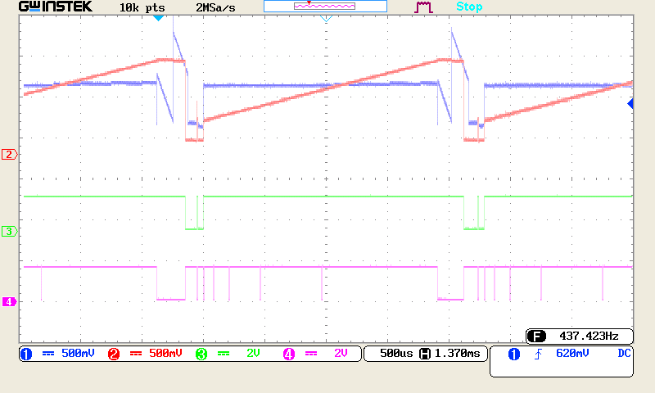
Pixel Level Sequential Time-to-Digital ADC with Wide Dynamic Range
and High SNR for High-Resolution Microbolometer FPA
Jong-Beom Kim, Eun-Ji Won, Doo-Hyung Woo
School of Information, Communications and Electronics Engineering The Catholic University of Korea
Introduction
Infrared camera configuration
Proposed readout integrated circuit system
▪ nine (3 × 3 array) microbolometers share one unit circuit. ▪ The size of the entire array is 1026×768, and the unit circuit has an array of 342×256. ▪ Temp. sensor: To detect substrate temperature. ▪ Dark sensor: To obtain the reference value of a dark current. ▪ Suppression circuit: controls the bias and dark current of the microbolometer.
▪Infrared cameras are attracting attention as a solution for self-driving cars because they can identify objects even under conditions that are difficult to identify with the eyes.
▪Demand for small and low-power infrared cameras is increasing as demand for smart homes, IOTs, and wearable devices increases.
▪Improving image quality with small size and low power requires a wide dynamic range and a high signal-to-noise ratio.
Temp. sensor
Suppression circuit
Dark sensor
13-bit ADC/DAC
‘3×3’
array
Unit cell
circuit
Timing circuit
Reference signal generator
Row Counter
Row scan
342×256× ‘3×3’
array
Proposed readout circuit
Column multiplexer
Proposed Pixel-Level ADC
Unit cell ($3×3$ pixel array) circuit
V_{SAT}
V(C_{INT})
I₁
V_{th1}
I₂
Unit circuit for typical Single Slope ADC
M_{p3}
M_{p2}
DAC
V_{th2}
I₃
M_{p1}
C_{M}
V_{CM}
φ _{SEL_C}
φ_{S}
V_{RST}
V_{ramp}
T
2T
$2^{2}$T
$2^{3}$T
T_{max}
T`_{max}
T`_{max_end}
Time
High Precision Bias Suppression
I_{B}
φ_{RST}
φ_{RST}
φ_{SEL_C}
…
DAC
M_{ps}
M_{p4}
φ_{HOLD}
φ_{S}
C_{INT}
φ_{cds switch}
φ_{Vth_L_active}
φ_{Vth_H_active}
φ_{Ramp_active}
φ_{RST}
C_{M}
I_{S}
A₁
V_{Y}
A₂
Level
Shifter
Detector
write
13-bit
SRAM
φ_{Vth_L_active}
φ_{Hold}
V_{CM}
φ _{DAC}
φ_{S}
R_{BB}
V_{B1}
C_{CDS}
V_{B2}
V_{ramp}
Column multiplexer
φ_{Vth_H_active}
M_{p3}
M_{p1}
M_{p2}
φ_{RST}
3 × 3
sensor
V_{rst}
V_{th2}
V_{sat}
Switch control
φ_{Ramp_active}
Integration & ADC
Readout
(0.15 ms)
Power control
Maximum integration time (1.95 ms)
C_{INT}
φ_{RST}
Schematic diagram of the proposed ADC
13-bit Counter
1/9 frame (2.2 ms)
V_{ps}
M_{ps}
I_{B}
φ_{HOLD}
A₁
Timing diagram of the proposed ADC
R_{BB}
I_{S}
V_{B1}
V_{B2}
A₂
▪ Integrator, A₁
- Time division integration for 2.21ms.
- Integration of sensor current I_{S} and DAC output.
▪ Comparator, A₂
- CDS for suppressing low-frequency noise.
- Comparing the output of the integrator with the reference (V_{B2}).
▪ Using the Sequential Method
- Enable efficient use of time and guarantee sufficient integration
time.
▪ Using the Time-to-Digital Method
- Perform integration and A/D conversion simultaneously.
- Valid information on the saturated voltage before the maximum
integration time can be obtained, so the operating range is wide.
▪ Control signal
- φ_{SEL_C} : resend V_{CM}.
- φ_{RST} : comparator reset.
- φ_{HOLD} : Integrate the current signal I_{S}.
- φ_{L} : Activate the comparator.
- φ_{RAMP} : Supply a signal in the form of a ramp.
▪ Large current signal : I_{S2}
- Stop comparing with V_{TH} and compare with V_{SAT}.
- When the comparison with V_{SAT} is completed, the comparison
is completed as soon as it is saturated.
▪ Small current signal : I_{S3}
- the integral signal does not reach V_{SAT}.
- a Ramp-type V_{SAT} is used to enable comparison for small current input.
▪ Sequential time-to-digital ADC
- All signals are shifted for sequential operation.
- By shifting the signals, the VCM delivery time and integration start
time were sequentially operated in row units.
I_{B}+ I_{S}
▪ In the case of a general microvolometer, the bias current is larger than the signal current.
▪ The High Precision Bias Suppression circuit is used to remove the bias current.
▪ Ensure sufficient integration time with a limited integration capacitor.
▪ Activate the switch to enable the feedback circuit for amplifiers $A_{1}$ and $A_{2}$.
▪ Determine $V_{CM}$, which serves as a variable resistor on $M_{p1}$, to remove the bias current for each pixel.
1.54ms
1/9 frame (2.22 ms)
0.48ms
0.2ms
1/9 frame (2.22 ms)
6 μs
1/9 frame (2.22 ms)
6 μs
6 μs
1.96 ms
0.25 ms
4 μs
V_{CM[1]} update
2.21 ms
4 μs
V_{CM[1]} update
I_{S[1]} integration&ADC
R/O_{[1]}
V_{CM[1]} update
I_{S[1]} integration
13-bit SS ADC_{[1]}
R/O_{[1]}
I_{S[1]} integration & 13-bit Time-to-Digital ADC
R/O_{[1]}
V_{CM[2]} update
V_{CM[3]} update
I_{S[2]} integration&ADC
R/O_{[2]}
V_{CM[2]} update
I_{S[2]} integration
13-bit SS ADC_{[2]}
R/O_{[2]}
V_{CM[2]} update
I_{S[2]} integration & 13-bit Time-to-Digital ADC
R/O_{[2]}
…
I_{S[3]} integration&ADC
R/O_{[3]}
…
V_{CM[3]} update
I_{S[3]} integration
13-bit SS ADC_{[3]}
R/O_{[3]}
V_{CM[3]} update
I_{S[3]} integration & 13-bit Time-to-Digital ADC
R/O_{[3]}
V_{CM[256]} update
I_{S[256]} integration&ADC
R/O_{[256]}
…
V_{CM[256]} update
I_{S[256]} integration
…
…
V_{CM[256]} update
I_{S[256]} integration & 13-bit Time-to-Digital ADC
…
Common single slope ADC
Sequential Single Slope ADC
Proposed Sequential Single Slope ADC
Experiment result
Mask layout & pixel array
Measured Waveforms
▪ DB Hitek 180nm BCDMOS
▪ Size of the array: 1026 x 768
▪ Size of unit pixel: 15 μm x 15 μm
Comparison
Parameter | Value
Detector pitch | 15 μm × 15 μm
Resistance | 10 MΩ
Thermal conductance | 0.7 × 10⁻⁸ W/K
Emissivity | 80 %
TCR | 2.5 %
Frame rate | 50 Hz
Bias current(I_{B}) | 40 – 120 nA
Signal current(I_{SIG}) | 0 – 8.8 nA
Maximum integration time(t_{INT.MAX}) | 1.95 ms
Integration capacitor(C_{INT}) | 1 pF
Power consumption | < ?? μm/pixel
integration and 13-bit A/D conversion
Switch Control Signal for Time-to-Digital variable clock operation
Shift operation for variable clock
Conclusion Summary
To design a signal acquisition circuit for a high-resolution microbolometer, a high precision bias suppression
circuit and a sequential time-to-digital ADC in pixel units were proposed. The proposed signal acquisition circuit is suitable for System-on-Chip
applications that require an infrared detection system and provides excellent infrared image quality by guaranteeing a wide operating range and high SNR for infrared detection signals.
This work was supported by the IDEC (IC Design Education Center) of KAIST.
 | Dynamic range [dB]
(A) | 65.5
(B) | 56.2
(C) | 80.9
2023 IDEC Congress(CDC)

